Slide 1
Recycling Cultures and Practices
Team 6
Kaylee Cabral, Josiah Allard, Daniel Furtado, Gregory Pereira, Atefeh Rahmani

Slide 2
Introduction
Our team hopes to have created a survey that could be used to evaluate the current state of recycling practices at UMass Dartmouth which hopefully gives us important insight on how to improve on diminishing waste on campus in future years. With this being said, our team has hypothesized that improving education of our population with regards to recycling, their recycling practices will improve.

Slide 3
Results, Analysis & Findings

Slide 4
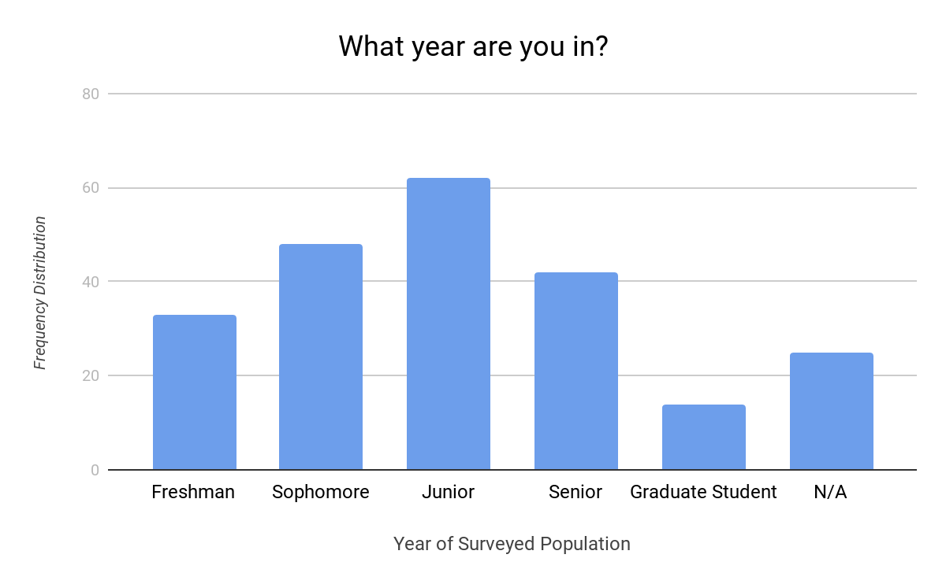
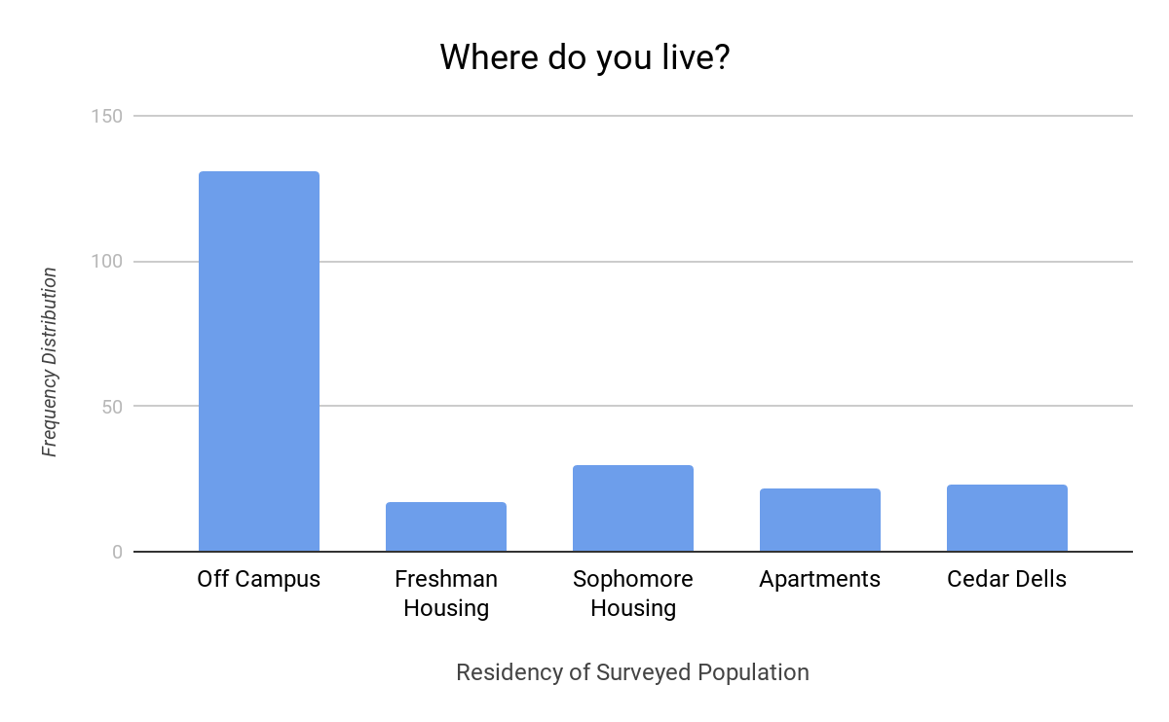
Surveyed Population
Results
Analysis/Findings
The majority of our population consists of students with the minority being faculty and staff. Out of this group we found that commuters were the largest group surveyed but resident students didn’t fall too far behind. When it came to gender the number of males and females were very close . When it came to the year of students surveyed we had a normal distribution between each year with the majority begin from the College of Engineering and College of Arts & Science. Lastly, a small percentage of our population came from athletes leaving the majority to be nonathletes.
Questions Asked
What is your role on campus?
Where do you live?
What is your gender?
What year are you in?
What department are you in?
Are you participating in any sports at UMass Dartmouth?

Slide 5
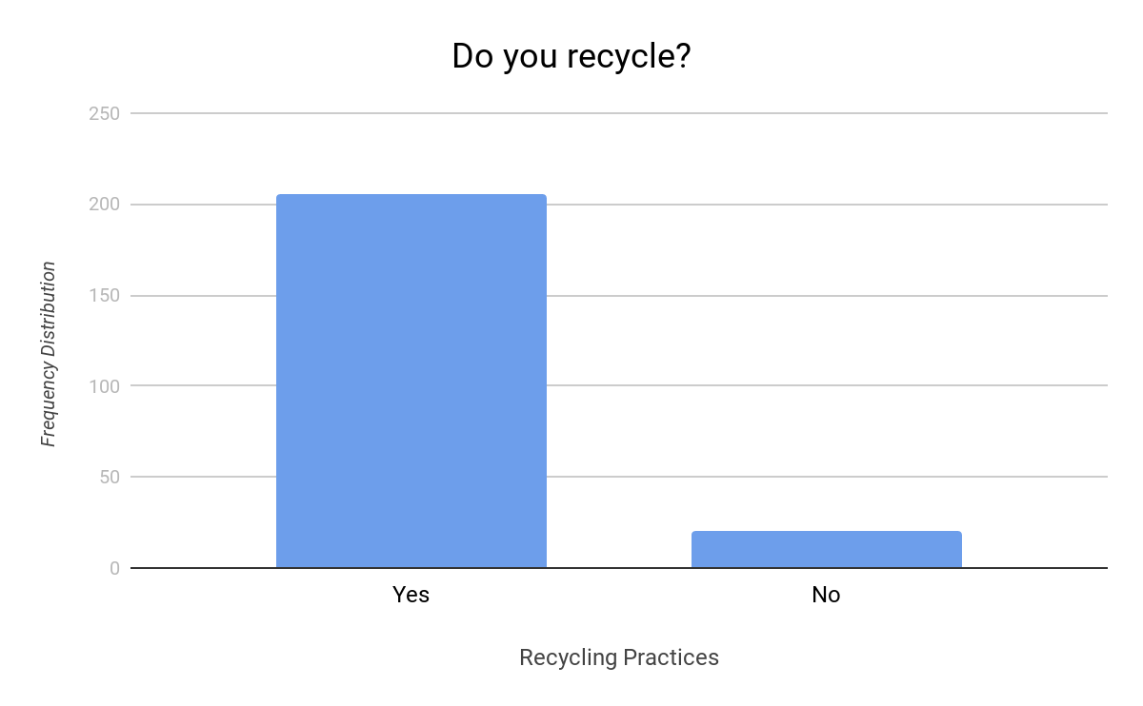
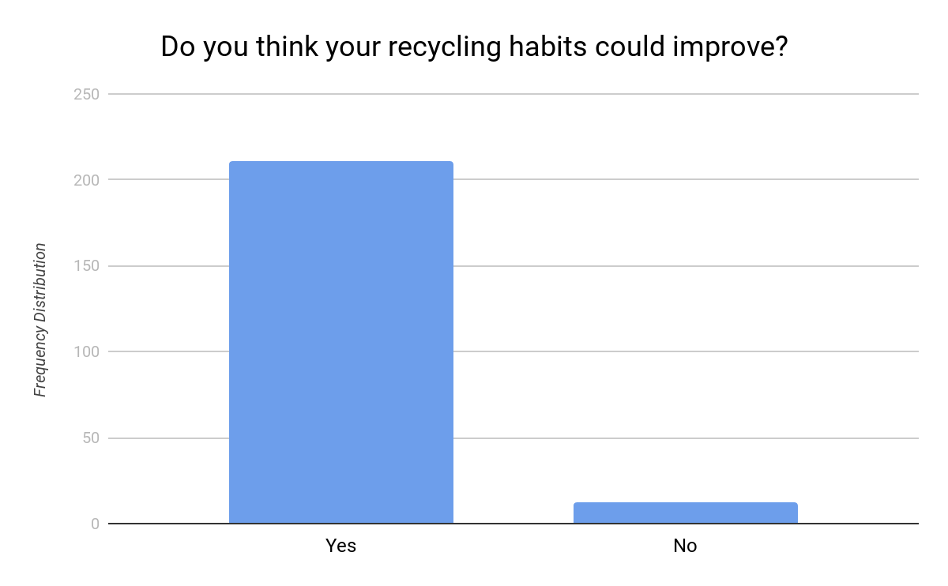
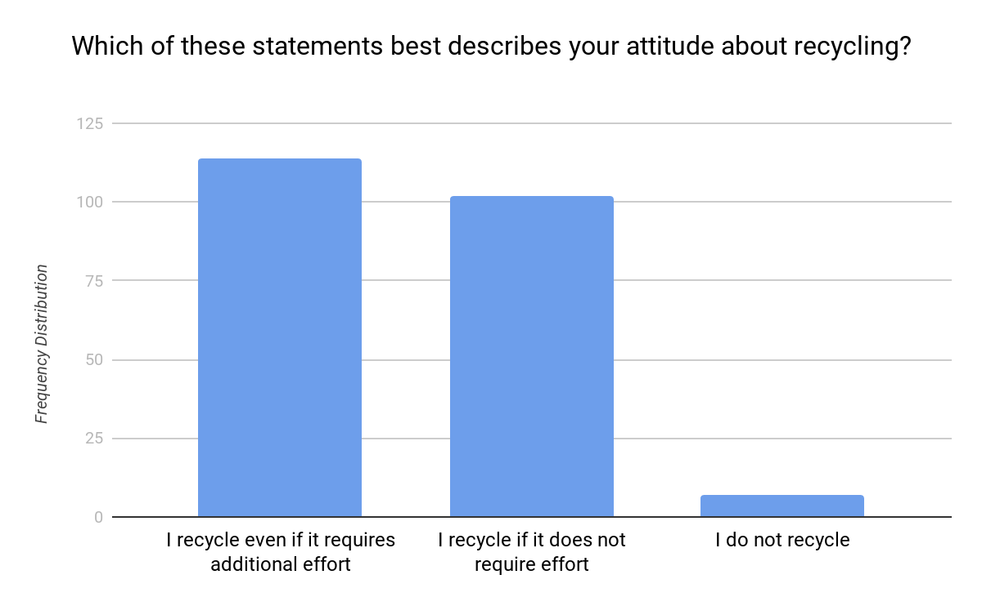
Attitude Towards Recycling
Questions Asked
Do you recycle?
Do you think recycling can be more convenient?
Do you think your recycling habits could improve?
Which of these statements best describes your attitude about recycling?
Analysis/Findings
Based on our results we can see that the majority of our population has stated they do recycle. Along with this finding we have also concluded the majority believes recycling could be more convenient and believes their recycling habits could be improved. We also asked about their attitude towards recycling and the population seemed to be very split between ‘recycling if it requires additional effort’ and ‘recycling if it does not’.

Slide 6
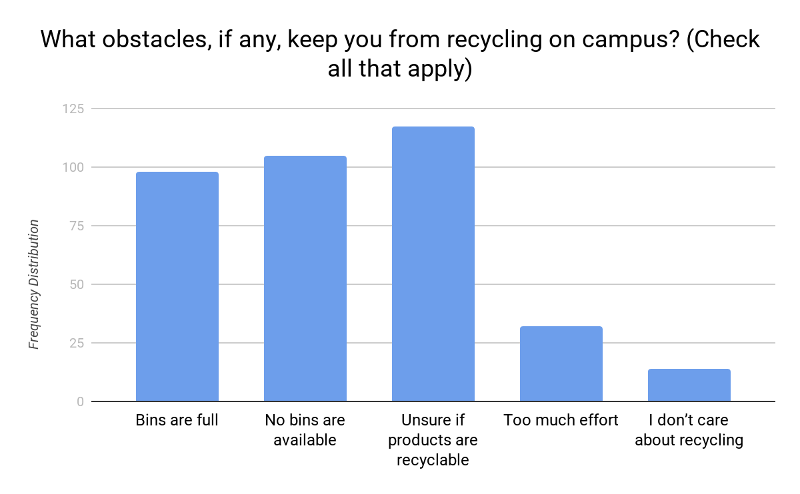
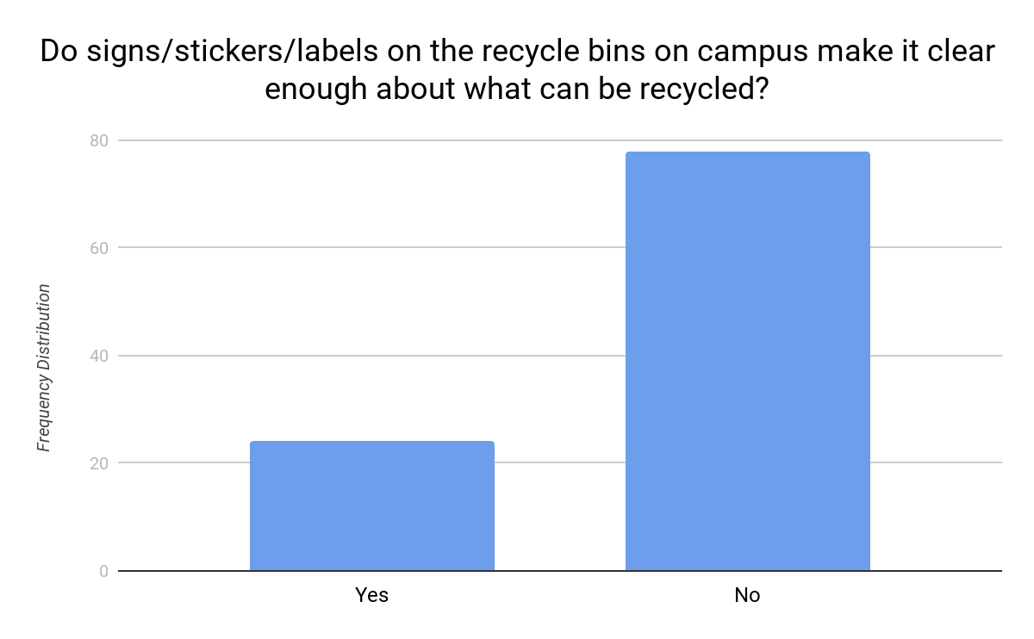
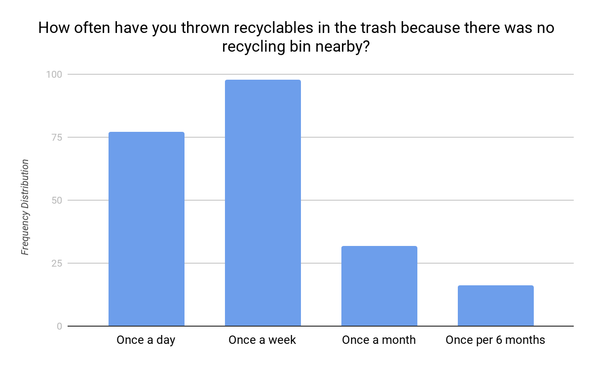
Recycling Practices on Campus
Analysis/Findings
When asked what obstacles keep you from recycling on campus the majority voted that ‘being unsure if products are recyclable’ was a reason. We can conclude from this that the population is not properly educated on recycling. Along with that response, ‘bins being full’ and ‘no bins being available’ were also often checked together. Another question asked was how often do you throw away recyclables because there are no bins available and majority voted “once a week”. To gain even more insight on campus recycling we asked if the signs on the campus recycling bins made it clear on what could be recycled and the majority of the population voted no. From these results we can conclude that more bins need to be made available and signs need to be clearer.
Questions Asked
What obstacles, if any, keep you from recycling on campus?
Do signs/stickers/labels on the recycle bins on campus make it clear enough about what can be recycled?
How often do you throw recyclables in the trash because there was no recycling bin nearby?

Slide 7
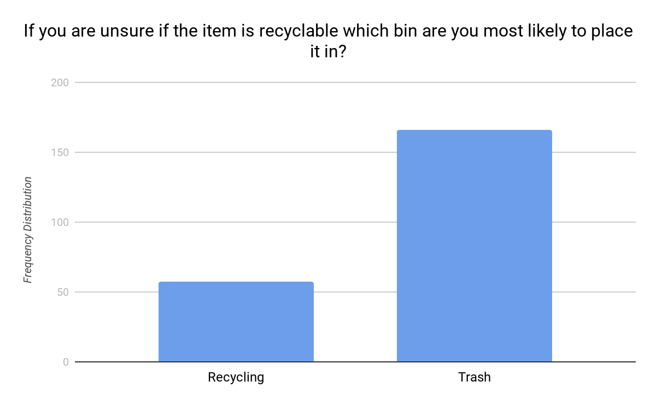
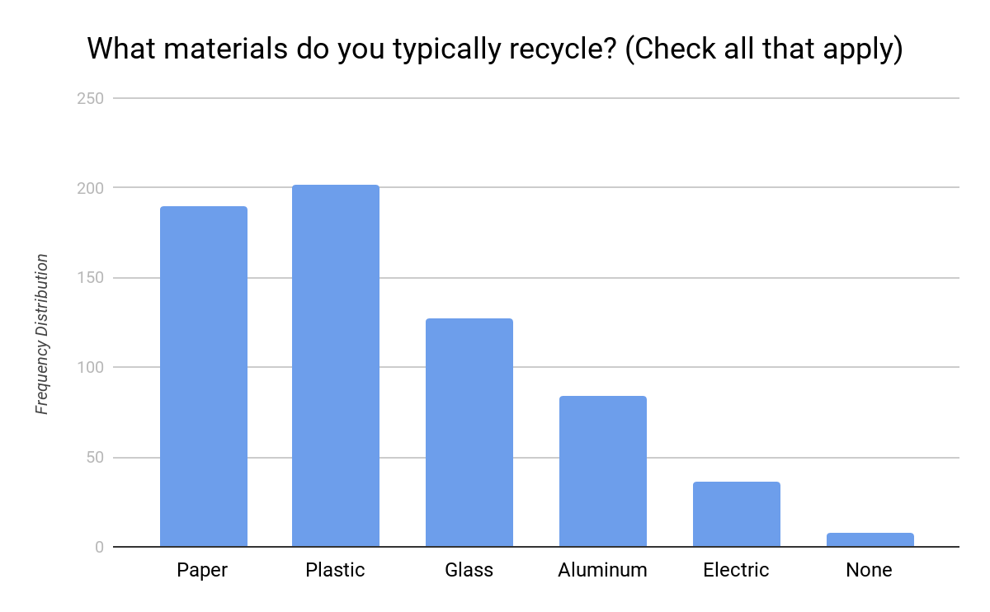
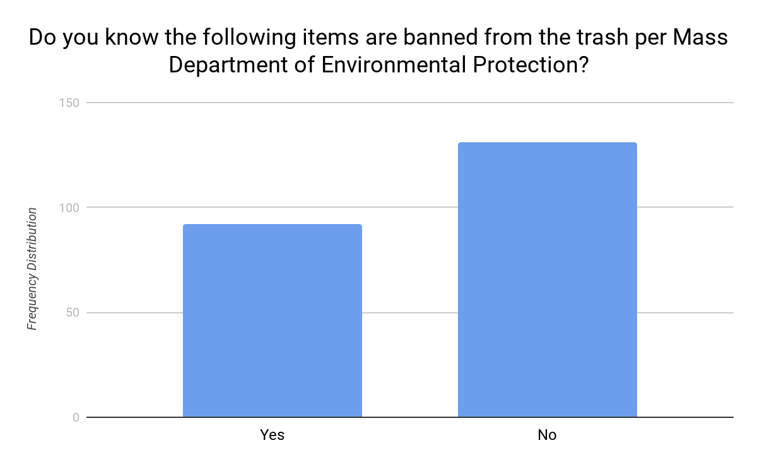
Knowledge on Recycling
Questions Asked
Analysis/Findings
We asked these questions to gain insight on how our population is educated. When asked if they knew the following items were banned from the trash the majority voted no. When asked what type of materials do you typically recycle the majority stuck to the basics, paper and plastic. This leaves us to think that the population is unsure if glass, aluminum, are recyclable. A few people also said that they recycle electrical equipment. Since electrical equipment can not be recycled, we can conclude that they are not educated on that as well.
What materials do you typically recycle?
If you are unsure if the item is recyclable which bin are you most likely to place it in?
How do you dispose of plastic grocery bags?
Do you know the following items are banned from the trash per Mass Department of Environmental Protection?
-Paper Cardboard
-Yard Waste
-Plastic containers
-Glass containers
-Aluminum and Metal containers

Slide 8
Recommendations
Based on our results and findings we have noticed that a lot of people are confused on what is actually recyclable and what isn’t. To diminish waste and improve on recycling practice on campus I’d suggest educating the population. Although this may be a tough task to accomplish, things like making signs on bins clearer for those who aren’t well educated on recycling could make a difference. Along with clearer signs we can make sure bins are emptied regularly and placed throughout campus and residence halls better.

Slide 9
Questions?

